Slide 1

Space racing with Data Science
Luiz Guardini
March 6th 2024

Slide 2





OUTLINE
Executive Summary
Introduction
Methodology
Results
Conclusions

Slide 3


EXECUTIVE SUMMARY
Objective: Determine the price of each launch of a commercial exploration launcher.
Can we reuse the first stage rocket?
Can we create a company to compete in the space exploration using SpaceX data to determine the reusability of the first stage launcher?
By gathering information from SpaceX space program (methodologies).
Collect public data through APIs and Web Scraping.
Complete Data Wrangling
Perform Exploratory Data Analysis with SQL and Data Visualization
Implement Visual Analysis with Data Visualization and Folium
Execute Predictive Analysis with the aid of Machine Learning techniques, such as SVM, KNN, Decision Trees and Logistic Regression
Summary of the results:
SpaceY has to be ready for a learning curve period where most likely many unsuccessful mission will occur, but with the correct investment, it is possible to create a solid space exploration company.
This analysis helped us to understand that the success rate of over 76% can be achieved by choosing the right location for a launch site in combination with Orbit and Payload values.
Detailed results will be provided though out the presentation.

Slide 4
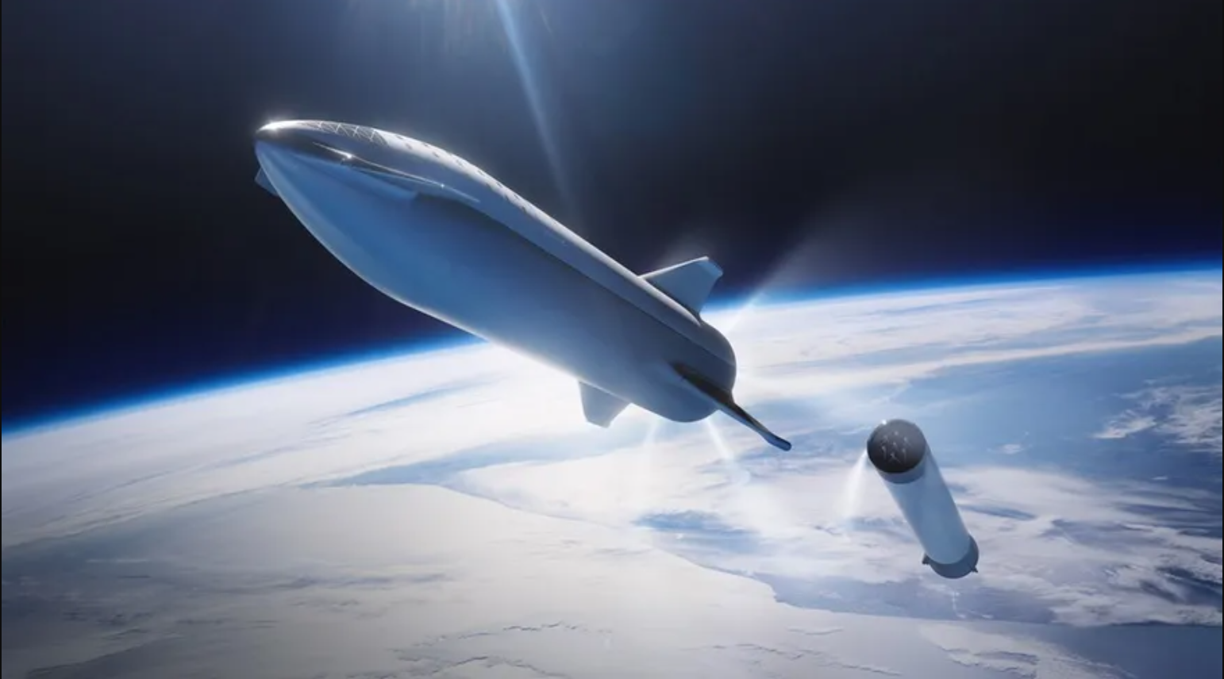
Methodology
Section 1

Slide 5
METHODOLOGY
DATA COLLECTION AND DATA WRANGLING
Data Collection from public SpaceX data.
api.spacexdata.com/v4/
API has different endpoints:
/capsules
/cores
/past
/rockets
/launchpad
/payloads
Web scraping
Gather data from SpaceX wiki page
Use BeautifulSoup to handle data
Data Wrangling
Convert variables to correct type
Identify and correct missing values
Remove irrelevant data

Slide 6
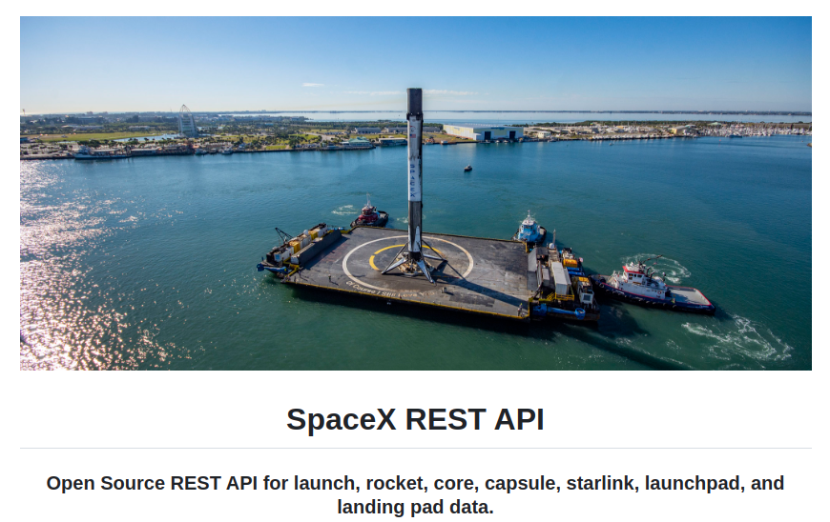
METHODOLOGY
DATA COLLECTION AND DATA WRANGLING – SPACE-X API
Data Collection from public SpaceX data.​
api.spacexdata.com/v4/​
API has different endpoints:​
/capsules​
/cores​
/past​
/rockets​
/launchpad​
/payloads

Slide 7
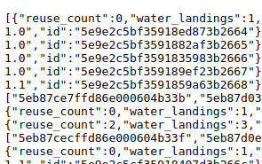
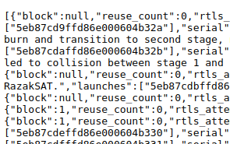
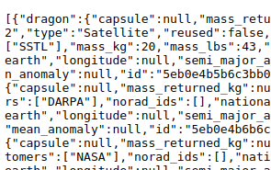
METHODOLOGY
DATA COLLECTION AND DATA WRANGLING – SPACE-X API
https://api.spacexdata.com/v4/
https://api.spacexdata.com/v4/capsules/
https://api.spacexdata.com/v4/cores/
https://api.spacexdata.com/v4/payloads/
...

Slide 8
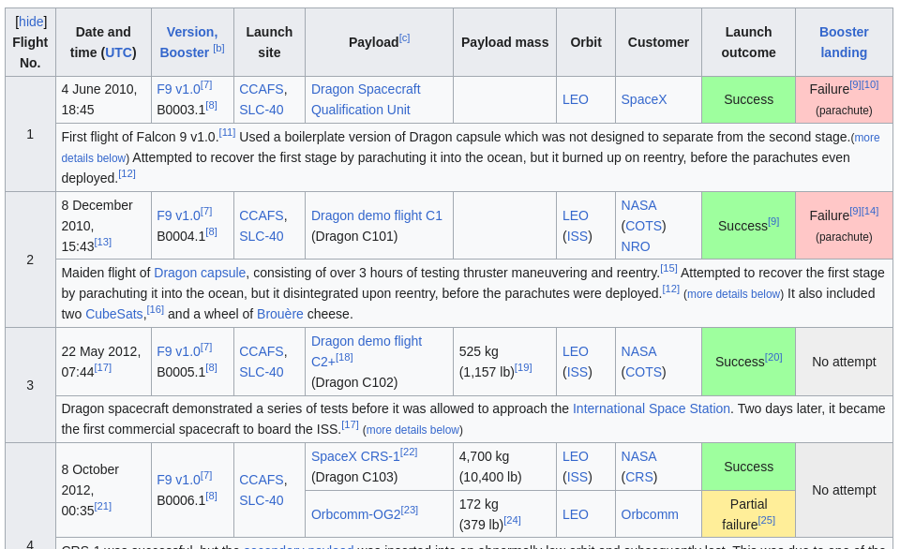
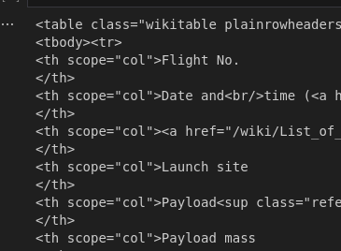
METHODOLOGY
DATA COLLECTION AND DATA WRANGLING – WEB SCRAPING
Gather data:
Create BeautifulSoup object
https://en.wikipedia.org/w/index.php?title=List_of_Falcon_9_and_Falcon_Heavy_launches&oldid=1027686922
Find tables
Create DataFrame

Slide 9
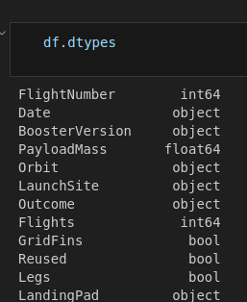


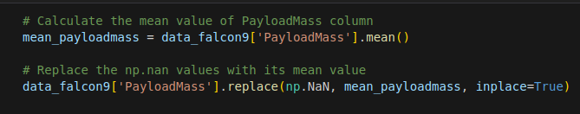
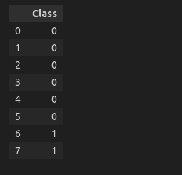

METHODOLOGY
DATA COLLECTION AND DATA WRANGLING – DATA WRANGLING
Data analysis
Identify which columns are numerical and categorical.
Deal with missing values
Replace missing Payload mass by its mean value
Correct Mission labels
Create dummy variables to categorize successful/unsuccessful missions

Slide 10
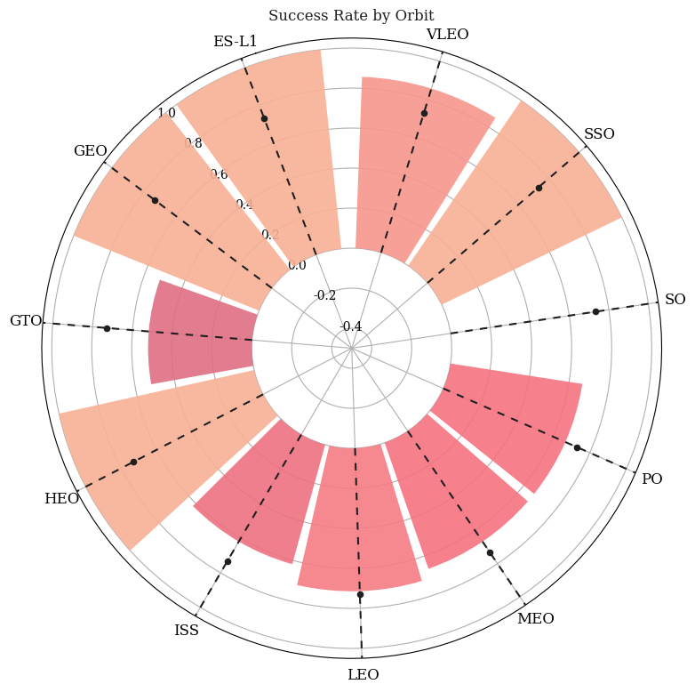
METHODOLOGY
EDA with DATA VISUALIZATION
Use Matplotlib and Seaborn to create relevant graphs to grasp information on the following indicators:​
Evolution of successful missions.​
Launch Success Yearly Trend.​
Launch Site success rate.​
Relationship between Payload and Launch Site.​
Success launcher landing per Orbit.​
Relationship between Flight Number and Orbit Type.​

Slide 11

METHODOLOGY
EDA with SQL
Load SpaceX dataset into PostgreSQL database to work within Jupyter Notebook.
Get insights from the data for the following instances:
Unique launch sites
Records where launch sites begin with string 'CCA'
Total Payload mass carried.
Average payload mass carried by booster F9 v1.1.
Date of the first successful landing.
Boosters with success in drone ship with specific payload range
Number of successful and failure mission outcomes
List boost versions
Failures for a corresponding year
Count landing outcomes

Slide 12
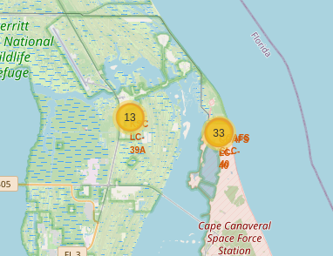
METHODOLOGY
EDA with INTERACTIVE VISUAL ANALYTICS - Folium
Mark all launch sites
Add map objects such as markers, circles and lines.
Mark success or failure of launches for each site
Assign feature launch outcomes according to feature class (0 for failure, 1 for success)
Use color-labeled marker clusters to identify site rate of success.
Calculate the distance between the site and a point of interest.

Slide 13
METHODOLOGY
EDA with INTERACTIVE VISUAL ANALYTICS - Dashboard
Build an interactive dashboard with Ploty Dash
Create a dropdown menu to select 'All sites' or a specific launch site
Create a slide range to select payload mass
Plot a pie chart to depict the launches per site
Plot scatter graph to show relationship between Successful Outcome and Payload Mass [Kg] for different booster versions.

Slide 14
METHODOLOGY
PREDICTIVE ANALYSIS (CLASSIFICATION)
GridSearchCV
SMV
hyperparameters
Decision Tree
Space X Falcon 9 Data
Split in Train and Test
Accuracy and Score Metrics
Best performing classification model
KNN
Logistic Regression

Slide 15

Insights from visual EDA
Section 2 - Results

Slide 16
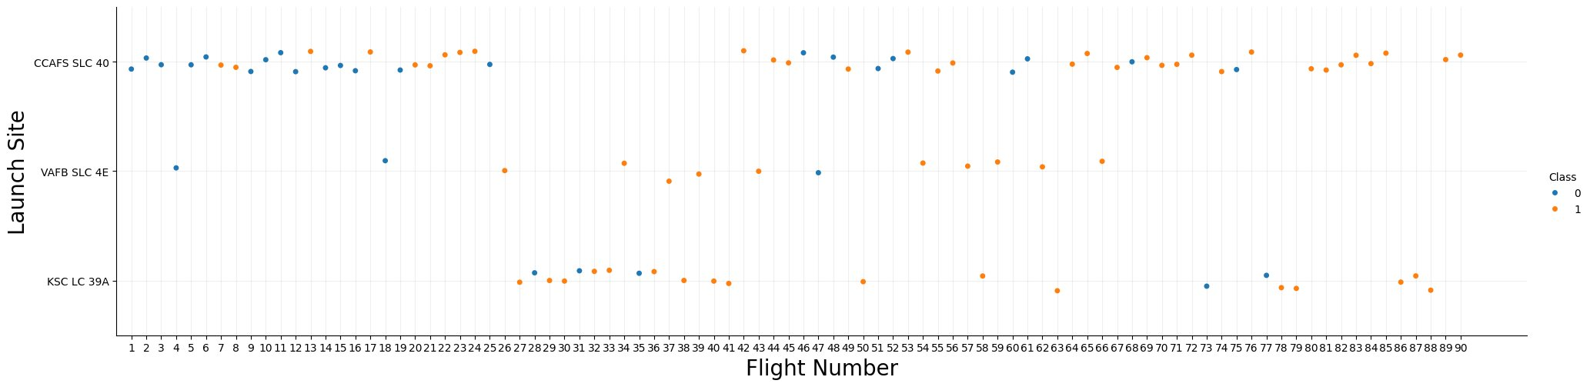
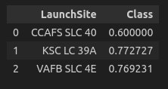
RESULTS – EXPLORATORY DATA ANALYSIS
Flight Number vs. Launch Site
Different launch sites have different success rates:
CCAFS LC-40, has a success rate of 60 %,
KSC LC-39A and VAFB SLC 4E have a success rate of 77%

Slide 17
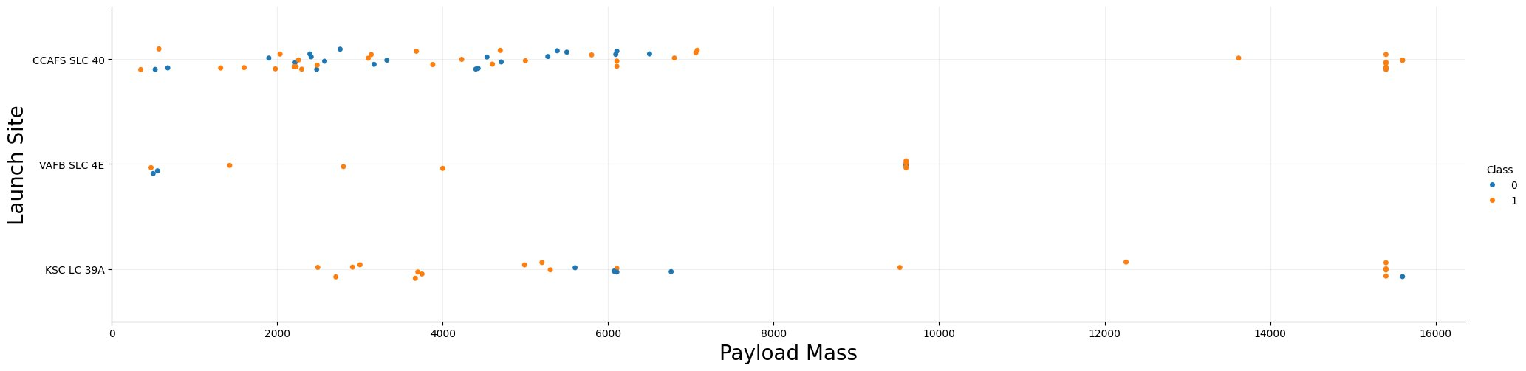
RESULTS – EXPLORATORY DATA ANALYSIS
Payload vs. Launch Site
VAFB-SLC launch site there are no rockets launched for heavy payload mass (greater than 10000).
The higher the payload, the higher the success rate.

Slide 18
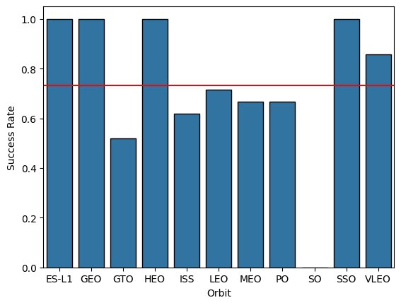
RESULTS – EXPLORATORY DATA ANALYSIS
Success Rate vs. Orbit Type
ES-L1, GEO, HEO, SSO and VLEO orbits have above the average success rate in stage 1 landing.
ES-L1, GEO, HEO and SSO have 100% success rate in stage 1 landing.
SO has no successful stage 1 landing

Slide 19
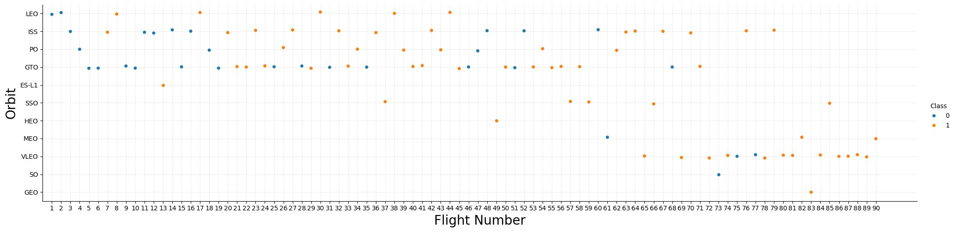
RESULTS – EXPLORATORY DATA ANALYSIS
Flight Number vs. Orbit Type
LEO orbit the Success appears related to the number of flights; on the other hand, there seems to be no relationship between flight number when in GTO orbit.
GEO has 100% success rate, but only one launch.
SO has 100% failure rate, but only one launch.

Slide 20
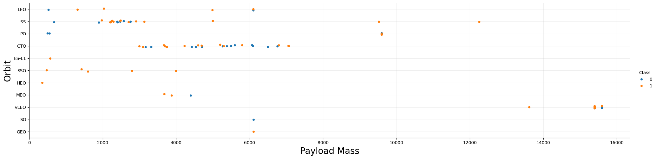
RESULTS – EXPLORATORY DATA ANALYSIS
Payload vs. Orbit Type
With heavy payloads the successful landing or positive landing rate are more for Polar, LEO and ISS.
For GTO we cannot distinguish this well as both positive landing rate and negative landing(unsuccessful mission) are both there here.

Slide 21
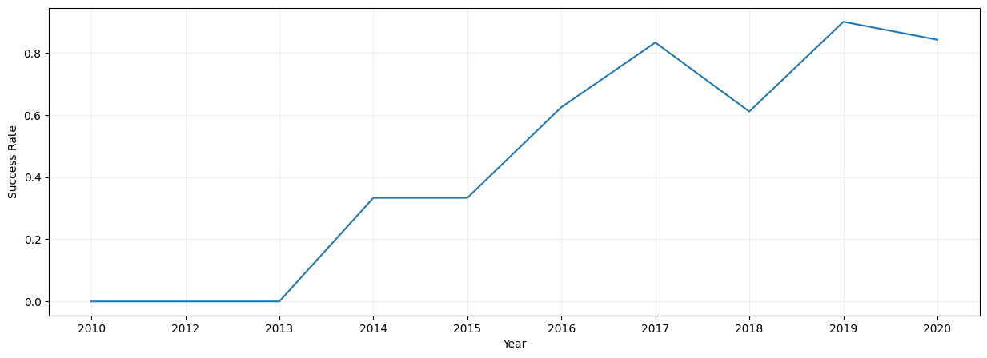
RESULTS – EXPLORATORY DATA ANALYSIS
Launch success yearly trend
Success rate since 2013 kept increasing till 2017 (stable in 2014) and after 2015 it started increasing.

Slide 22
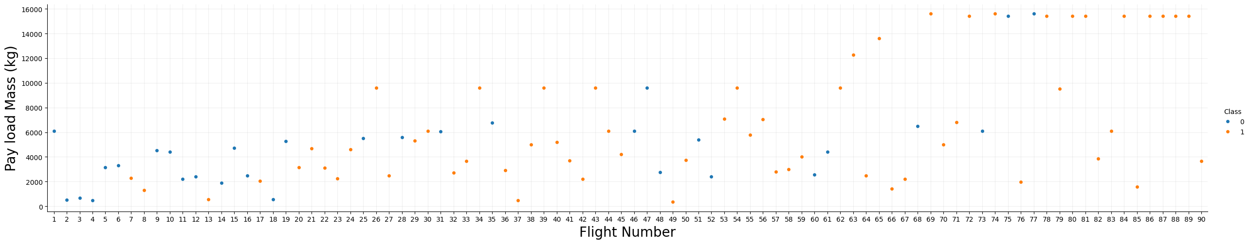
RESULTS – EXPLORATORY DATA ANALYSIS
Payload vs. Flight Number
As the flight number increases, the first stage is more likely to land successfully (red dots).
The payload mass is also important; it seems the more massive the payload, the less likely the first stage will return.

Slide 23
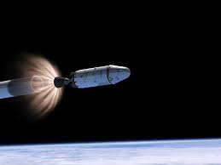
Insights from SQL EDA
Section 3 - Results

Slide 24
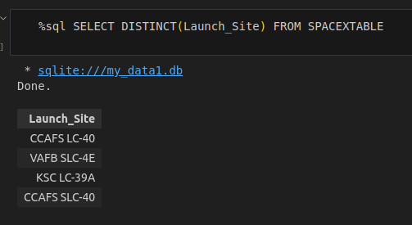
RESULTS – EDA - SQL
All launch site names:

Slide 25
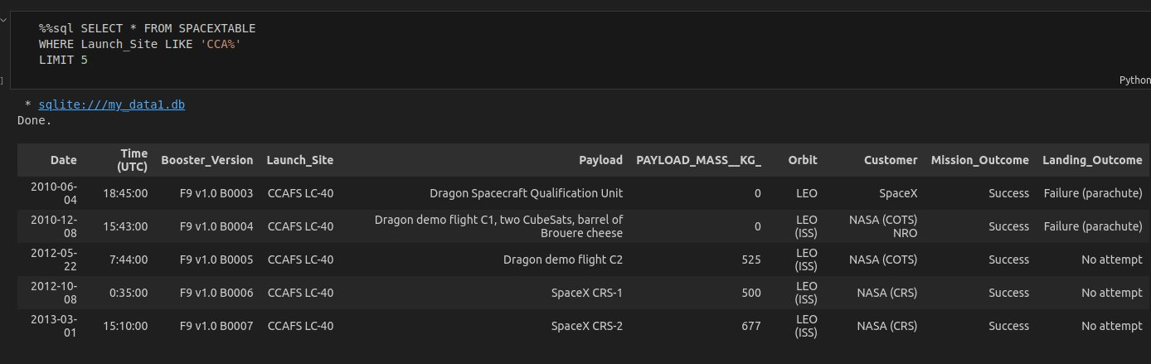
RESULTS – EDA - SQL
Launch site names begin with `CCA`:

Slide 26
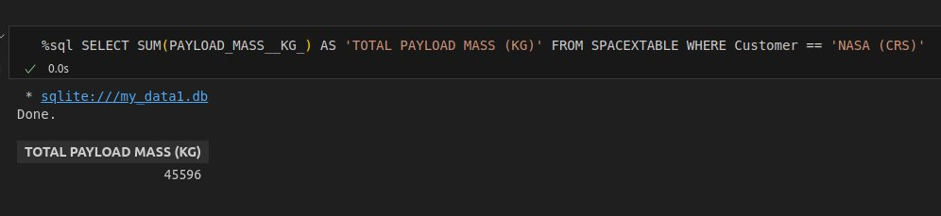
RESULTS – EDA - SQL
Total payload mass:

Slide 27
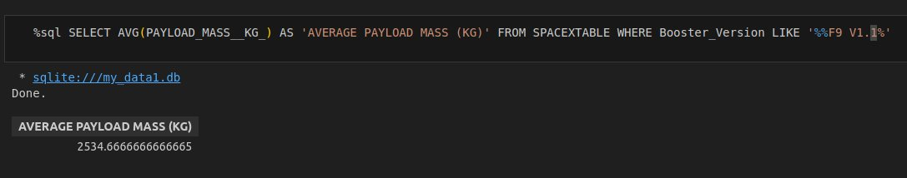
RESULTS – EDA - SQL
Average payload mass by F9 v1.1:

Slide 28
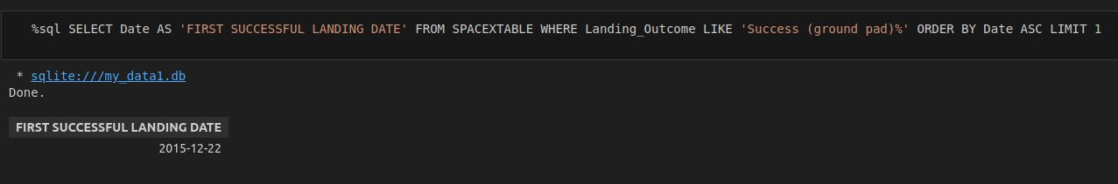
RESULTS – EDA - SQL
First successful ground landing date:

Slide 29
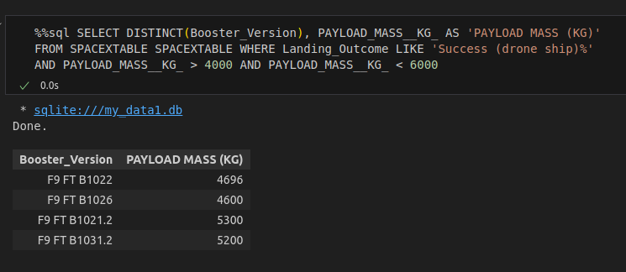
RESULTS – EDA - SQL
Successful drone ship landing with payload between 4000 and 6000:

Slide 30
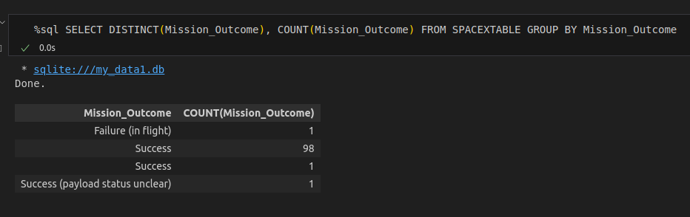
RESULTS – EDA - SQL
Total number of successful and failure mission outcomes:

Slide 31
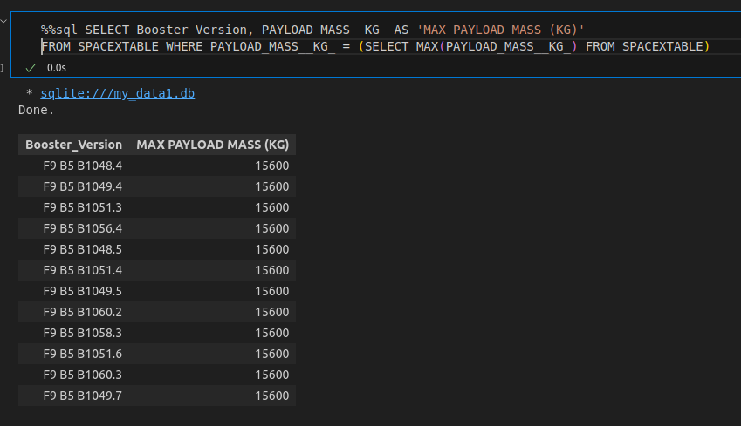
RESULTS – EDA - SQL
Boosters carried maximum payload:

Slide 32
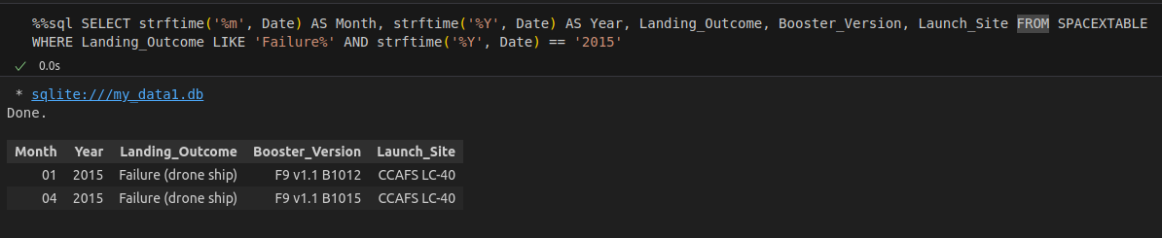
RESULTS – EDA - SQL
2015 launch records:

Slide 33
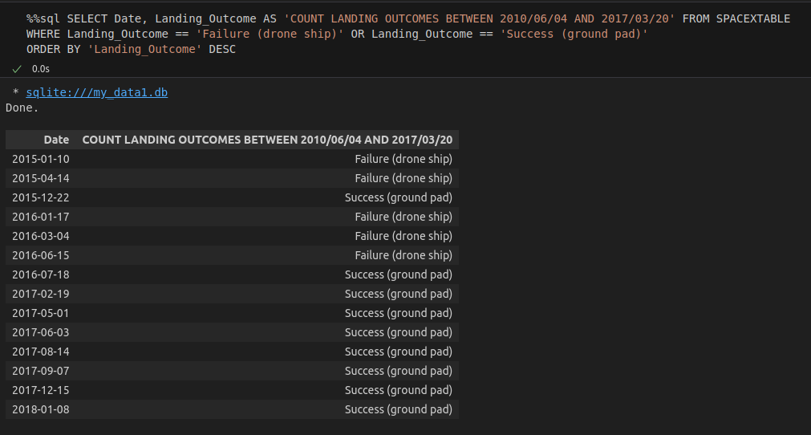
RESULTS – EDA - SQL
Rank success count between 2010-06-04 and 2017-03-20:

Slide 34
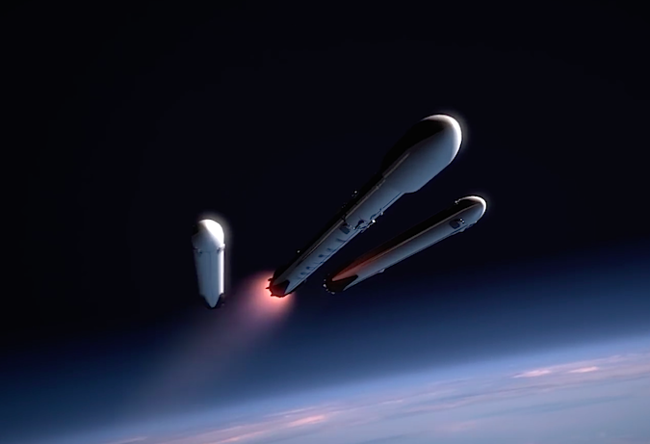
Launch Sites visual analysis
Section 4 - Results

Slide 35
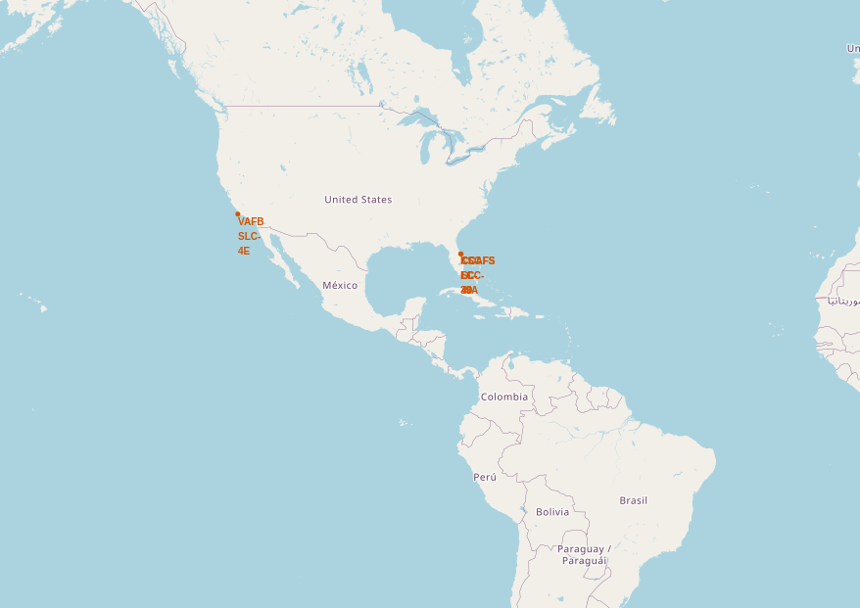
RESULTS – INTERACTIVE MAP
SpaceX launch sites are located in the United States of America, one in the coast of California and the rest near the coast of Florida

Slide 36
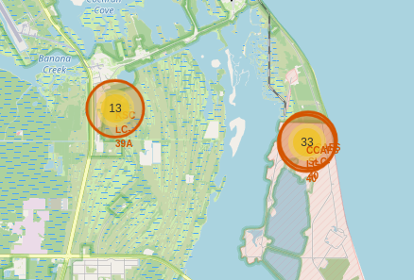
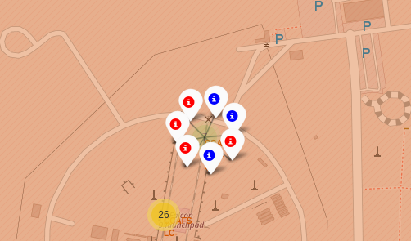
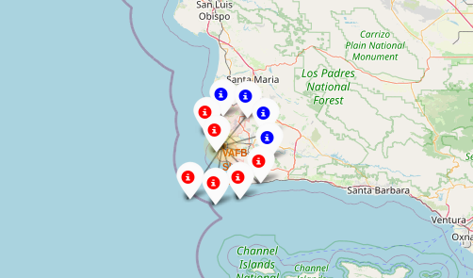
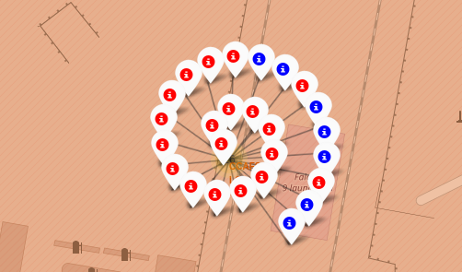
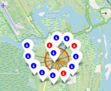
RESULTS – INTERACTIVE MAP
All Launch Records Per Site On The Map
CCAFS SLC-40
VAFB SLC
KSC LC-39A
CCAFS LC-40

Slide 37
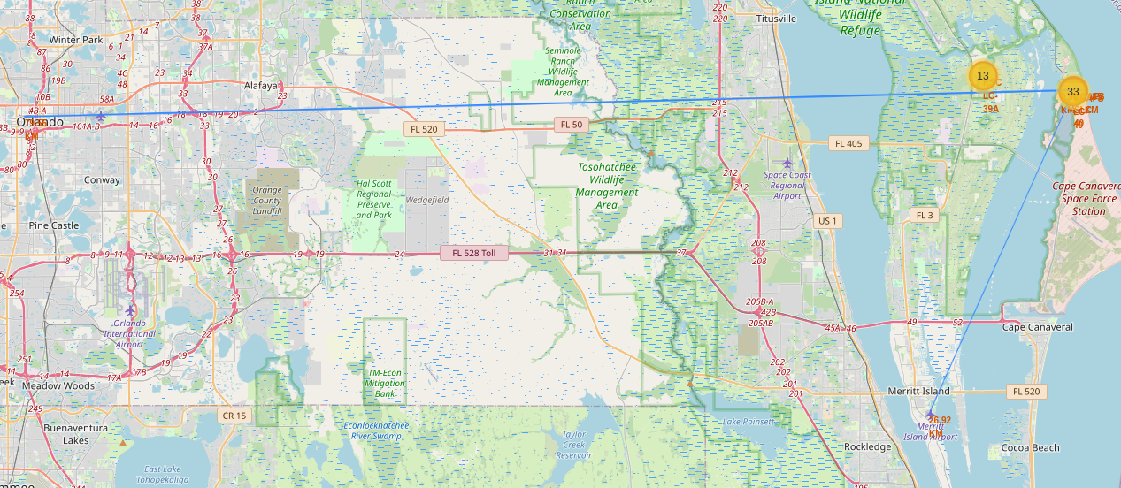
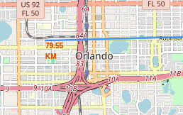
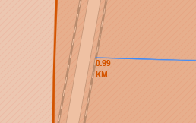
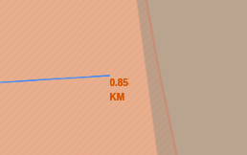
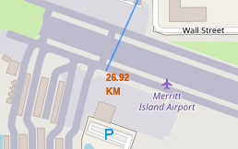
RESULTS – INTERACTIVE MAP
Distance from Orlando: 79 Km
Distance from Airport: 27 Km
Distance from railroad: 0.99 Km
Distance from coast line: 0.85 Km
CCAFS SLC-40 proximity analysis

Slide 38
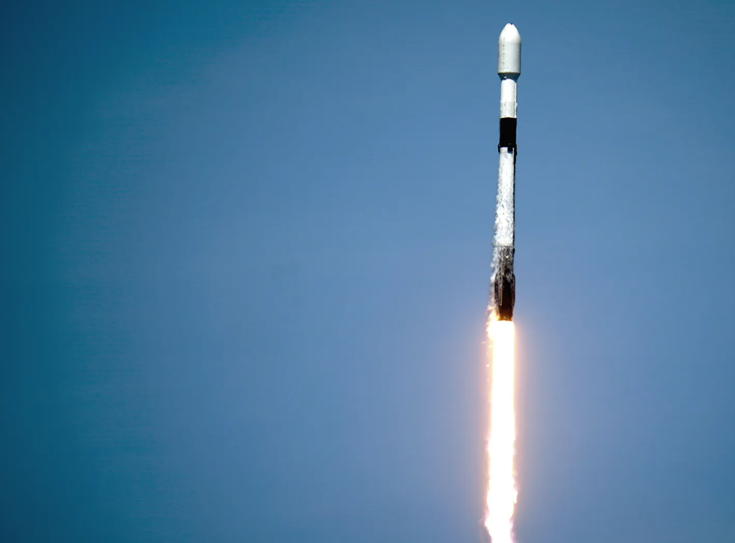
Dashboard with Plotly Dash
Section 5 - Results

Slide 39
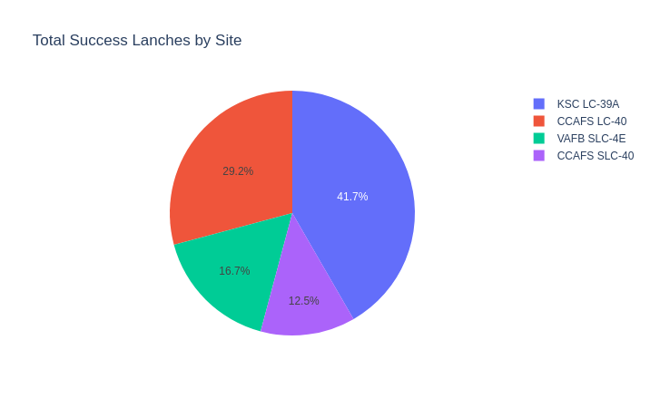
RESULTS – INTERACTIVE MAP
Launch success count for all sites
KSC LC-39A holds the most successful launches from all sites
CASFS SLC-40 has the least successful launch rate from all sites

Slide 40
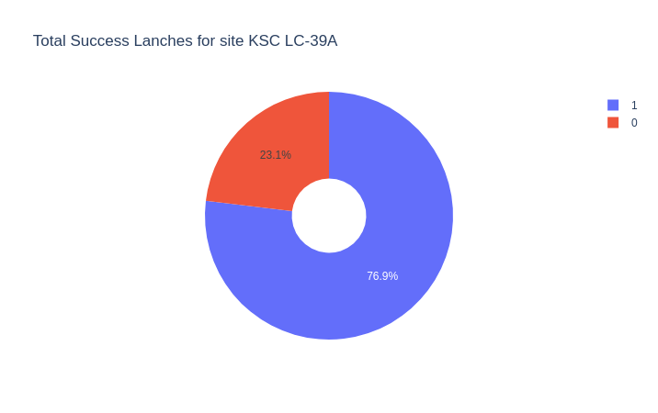
RESULTS – INTERACTIVE MAP
Launch site with the highest launch success ratio
KSC LC-39A has a 76.9% success rate

Slide 41
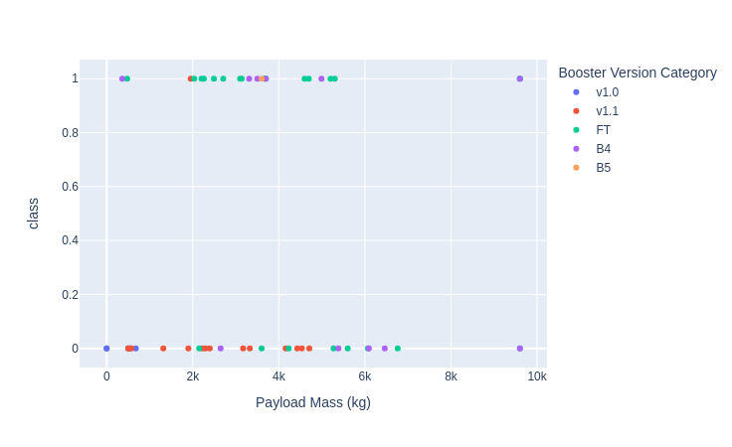
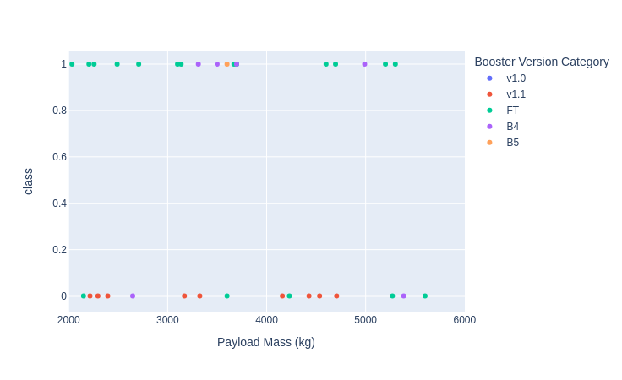
RESULTS – INTERACTIVE MAP
Payload vs. Launch outcome scatter plot for all sites
Payload from 0 to 10k
Payload from 2k to 6k
FT booster version has a high success rate for loads up to 4000 Kg
Booster v1.1 has a high failure rate for all payload range

Slide 42

Predictive Analysis (Classification)
Section 6

Slide 43
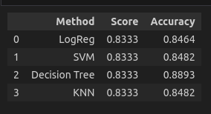
RESULTS – PREDICTIVE ANALYSIS
All methods scores equally in the mean accuracy on the given test data and labels.
Decision Tree method has a better Accuracy for the given test data and labels.

Slide 44

RESULTS – PREDICTIVE ANALYSIS
Confusion Matrix is a specific table layout that allows visualization of the performance of an algorithm. The fields allows us to compute accuracy of the model
In this case, we have 100% of true positive and 0% false negative for 'did' not land'. We have 20% (3 out of 15) false negative and 80% (12 out of 15) true positive for 'land'

Slide 45
CONCLUSION
From EDA with data visualization one can observe:
The correct combination of Lauch site, Orbit and Payload result can lead in a high success rate.
With heavy payloads the successful landing or positive landing rate are more for Polar, LEO and ISS.
From EDA with SQL
There was a hiatus of 5 years, (2010 – 2015) until the fully successful mission.
From interactive visual analytics
KSC LC-39A holds the most successful launches from all sites
CASFS SLC-40 has the least successful launch rate from all sites
FT booster version has a high success rate for loads up to 4000 Kg
Booster v1.1 has a high failure rate for all payload range
From classification model results
All methods scores equally in the mean accuracy on the given test data and labels.
Decision Tree method has a better Accuracy for the given test data and labels, being the best ML model for analysis using the corresponding parameters and criteria

